Slide 1


Slide 2


CAMEO issues
LtCol Jarosław OKRENT
AO IT&S CIS DIRECTORATE
EUROPEAN UNION MILITARY STAFF
THIS PRESENTATION IS: LIMITE
LIMITE

Slide 3
Agenda
Information Management – current status
IM – issues to solve
Proposed Migration to new structure
Other issues
  Naming convention,
  Broken card readers,
  check of implemented security roles.
Action List

Slide 4
IM– current status
CAMEO IM - (procedural aspect based on EOW SECOPS)
  KEY Personnel
  SCISM – IM policies (EUMS)
  CAMEO Manager – IM guidance and impl. (NOC)
  MILSAT CAMEO Manager
  Partner CAMEO Manager
  Content Managers

Slide 5
IM– current status
CAMEO IM (functionality- technical aspect based on manual)
  Roles:
  CAMEO Manager
  CAMEO Administrator
  Content Manager
  Contributor User
  Associate User

Slide 6
IM – issues to solve
Technical aspect – access privileges
Legal aspect
  Need to Share
  Need to Know

Slide 7
IM – issues to solve
Answer
SDA Access request
SCISM
Content
Manager
MILSAT
CAMEO
Manager

Slide 8
IM – issues to solve
Answer
SDA Access request
Content
Manager

Slide 9
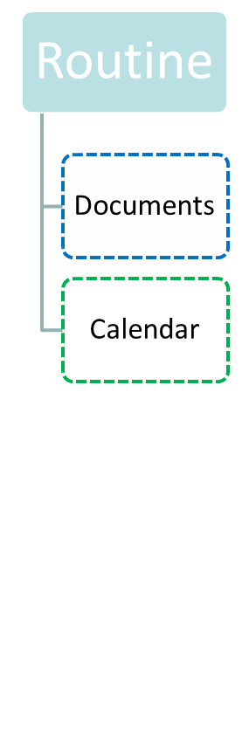
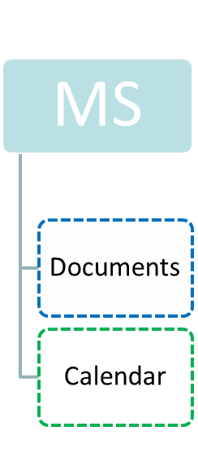
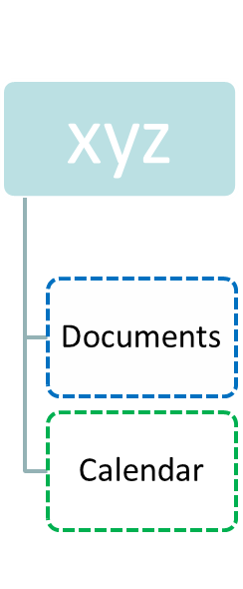
IM – issues to solve
Current structure should be change:
Naming
Management difficulties

Slide 10
Proposed Migration to new structure
Proposed Migration to new structure

Slide 11
Findings after Feasibility Study CAMEO Roles
CAMEO Administrator & Managers: only at EEAS - EUMS level (CAMEO Adm & MILSAT).
Content Managers: to be defined for each SDA/subSDA.
The current role of the Content Manager should be upgraded in order to grant him rights to assign/delete roles/users to/from his corresponding SDA and subSDAs.
Notes:
The current Content Manager can't assign roles to SDAs. The proposed "Power" Content Manager will be able to assign/delete roles/users to/from his assigned SDA and subSDAs.
The upgrade of the Content Manager role can be easily done by a CAMEO Manager (MILSAT) or CAMEO Administrator (Popovici) through the CAMEO Template Role Management menu.

Slide 12
What to do with the current structure?
1st choice: Use the archive function of CAMEO
  Drawback → after their archiving, the SDAs are accessible only by the CAMEO Managers.
2nd choice: Move all existing SDAs under a single one (e.g OLD_SDAs)
Drawback → It's not possible for CAMEO Managers to move SDAs.
Maybe this is possible for CAMEO Administrator?

Slide 13
New SDA structure
under ROOT
One SDA per Member State
One SDA per extraordinary user community
  EUMS
  SATCEN
  ...
Special SDAs
  Routine: for posting information of general interest
  Exercises : with subsequent subSDAs per exercise
  Operations / Missions : with subsequent subSDAs per Operation/Mission.
  ...

Slide 14
Principles for the new SDA structure
EEAS - EUMS to define the top level SDA structure.
One Content Manager assigned for each top level SDA, and becomes the Single Point of Contact for CAM and other users when it comes to his assigned SDA.
Top level SDA CMs will create the structure inside their SDAs and assign user roles.
All users should be able to see all the top level SDAs and the structure one level below in order to request access rights to the CMs.

Slide 15
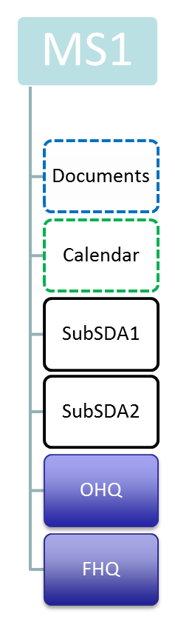
Example of MS SDA structure
Top level SDA created by CAMEO Manager (CAM) at EUMS level.
All default new user groups assigned as "associate" by EUMS.
One MS "Power" Content Manager (PCM) assigned by CAM MS.
MS PCM creates SubSDAs and assigns roles per user.
Created by default.
Accessible by all associates (i.e. all CAMEO groups/users)
Only for public info (e.g a list of all SubSDAs Content Managers)
One Power Content Manager assigned by MS PCM for each SubSDA
Power Content Managers assign roles/user for their SubSDA
Specific subSDAs.
Same rules as all other subSDAs
Only for MS that have O/FHQs
Proposal: common structure for all OHQs (TBD by EUMS & OHQ community)

Slide 16
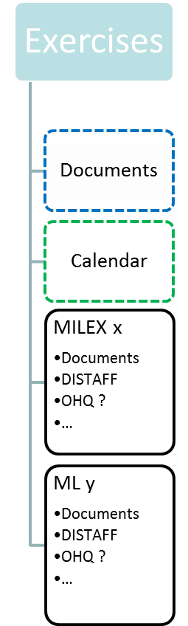
Example of Exercise SDA structure
Top level SDA created by CAMEO Manager (CAM) at EUMS level.
All default new user groups assigned as "associate" by EUMS.
One EUMS "Power" Content Manager (PCM) assigned by CAM.
MS PCM creates SubSDAs and assigns roles per user.
Created by default
Accessible by all associates (i.e. all CAMEO groups/users)
Only for public info (e.g a list of all SubSDAs Content Managers, general documents related to exercises etc)
During preparation/conduct of the exercise:
- One Power Content Manager (from EUMS) assigned by EUMS (e.g. an IMC for the exercise).
After the end of the exercise:
- Removal of Content Manager roles.
- TBD who should have access.
Notes:
During the planning and conduct of an exercise, an EUMS officer should be appointed as a Content Manager for that specific exercise. He will be able to assign users/roles to the SDA of the exercise, create subSDAs and assign Content Managers for them.
A common structure for each exercise subSDA should be defined.
After the end of the exercise, it has to be defined which users should have access in the SDA of the exercise and with what role.

Slide 17
Remarks for the new SDA structure
Top level SDA CMs can also create new SDAs under the root.
  can be controlled by CAMEO Managers/Administrator.
Top level & sub SDA CMs cannot delete SDAs they have created. They have make a request to a CAM.
  small extra workload for the CAM.
The "Documents" folder of the top level SDAs is not a private space, since all users (having been granted associate rights to all top level SDAs) have access to it.
  info of common interest can be uploaded there (eg list of SDA CM, contact info etc).
Special procedure will have to be agreed upon and applied for "specific" SDAs (e.g. operations, missions, exercises) after the end of the corresponding activity (who should become the content manager, who should have read rights etc)
  have to be defined in advance.
When it comes to operations & exercises, the use of the designated OHQ SDA (under the MS top level SDA) or the operation/exercise SDA will have to be clarified.
  have to be defined in advance

Slide 18
Other issues
  Broken card readers,
  Check of implemented security roles.

Slide 19
Naming Convention
Common\Corporate Naming Convention
Mixed
  Solan users – personal names (84%)
  External users – functional names
Functional Names – Business Continuity

Slide 20
Action List
Activity | Main Player | Contributor | Proposed Deadline | Remark
SDA structure - creation | EUMS-IMC | IBS7 | 20.05
Migration to new structure | IBS7 | EUMS-MILSAT | 20.05 | MILSAT – archive process
Broken Card Readers | EUMS-MILSAT
List of Content Managers | IBS7 | EUMS | 20.05 | Permanent Update
List of TopLevel Managers | IBS7 | EUMS | 20.05
Coordination meeting 23.05.2016 09:30

Slide 21

Questions?

